Slide 1
User Profile Recommender System Needs & Complications

Slide 2
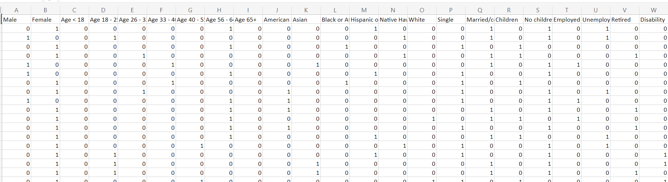
What we Have
In order to create a recommender system we need to have some type of way to connect users to each other.
With the simulated User Profiles (user features need to be updated) we should be able to create this initial connection (See below graphic)

Slide 3
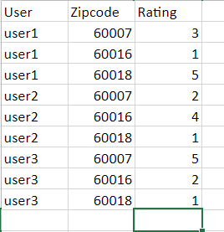
What we Need
Having a way to connect similar entities is only half of the problem
We also need something to recommend
Ex: Given that user1 and user2 are similar we recommend this zip code because???
We have to have a reason for recommending
This is where user rating by zip code could come in
Ex: Given that user3 & user4 are similar we recommend zip code 60007

Slide 4
User Rating Complications & Solutions
Complications
Why has a user given a specific rating?
Currently we don’t have the data to help us identify why a user would give a specific rating
How do we identify which zip codes fit the user profile
After finding a solution to question 1 we still need to figure out how a specific zip code aligns with a user
Solutions
Creating victim table for each user
Based on crime types which crimes are each user most worried about
Shilpi mentioned that she has done research into what factors have the highest probability of someone being a victim
If Shilpi and Chris can use research to fill out victim table or any other method this would fix this issue
Getting count data by crime type and zip code
We can count the number of crimes by crime type and zip code and apply a percentile ranking score for each crime
The higher the count for that crime type the higher the score will be on a range from 0 -1
Once we have ranking scores for each zip code and crime type we can set a threshold parameter for each crime that the user is most worried
Ex: if ranking for Battery >= .7, count += 1
Finally to assign ratings we add a simple if statement for each zip code
If count <= 5, rating = 5, count > 5 and < 7, rating = 4 …

Slide 5
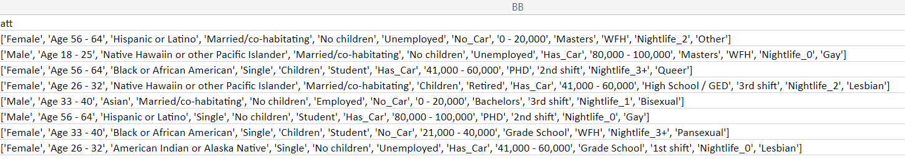
User Ratings Part 1 example
To help identify specific user traits I have added an attribute column to the user profile table (see image below)
Using the table below we can identify which crime types a Married 56 - 64 year old female with no children worries about the most

Slide 6
User Ratings Part 2 example
For each user we would count the number of crime types that they are most concerned about that are over a specific threshold
After getting crime count we would assign each zip code a rating based on those counts

